Slide 1
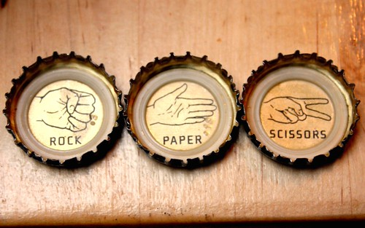
“ROCK ,PAPER, SCISSOR”
PREPARED BY :
DIVYA SHARMA
SABINA PUWANLI
This Photo by Unknown Author is licensed under CC BY-SA

Slide 2
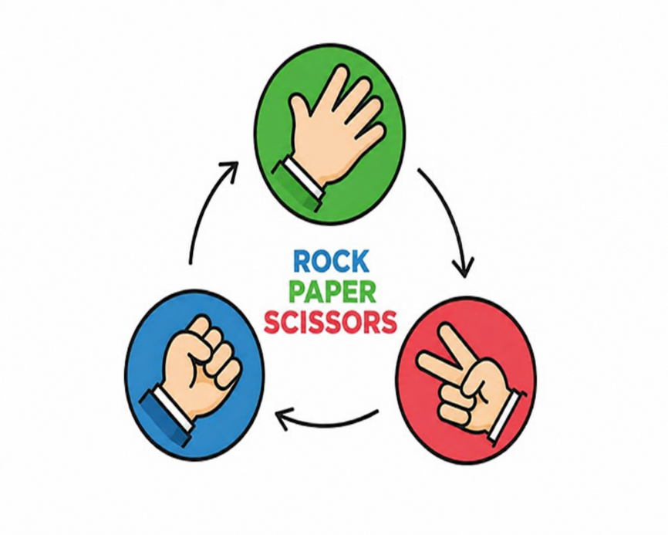
INTRODUCTION
Rock Paper Scissors is a simple and popular hand game played between two players.
This project develops a digital version of the game using the C programming language.
The system provides user registration, login, single-player and multiplayer modes.
It uses file handling to store player information, match history, and leaderboard records.
The project demonstrates the practical application of C programming concepts in developing a complete software application.

Slide 3
OBJECTIVE
The main objective of this project is to develop a complete Rock Paper Scissors gaming system using C programming language. Here are some specific objectives listed below:
To implement multiple gameplay modes including player versus computer and multiplayer functionality.
To use file handling for storing player records, maintaining match history, and displaying scoreboards.
To create Dashboard that provides easy access to gameplay, match history, leader board and user options.

Slide 4
PROBLEM STATEMENT
The following problems motivated the development of this project:
1. Lack of User Management The traditional game does not provide a registration or login system, making it impossible to identify different players or maintain individual player records.
2. No Permanent Data Storage
3. Absence of Match History and Leaderboard Players cannot review previously played matches or compare their performance with other players through a leaderboard
4. Limited Gameplay Features The traditional game offers only basic gameplay and lacks additional features.
To overcome these Limitations, this project develops a console-based Rock Paper Scissors Game using C programming language with user registration, login, single player and multiplayer modes, score management, match history, leaderboard, and file handling for permanent data storage.

Slide 5
TEAM MEMBERS CONTRIBUTION
S.N. | Task / Activity | Divya Sharma | Sabina
1 | Requirement Analysis and Literature Review & Background Study | ✔ | ✔
2 | Problem Statement & Objectives | ✔ | ✔
3 | System Design (DFD & Flowchart) | ✔ | ✔
4 | User Registration Module | ✔
5 | Login Authentication Module | ✔
6 | Single Player Game Module | ✔
7 | Multiplayer Game Module | ✔
8 | Leaderboard Module |  | ✔
9 | Match History Module |  | ✔
10 | Profile Update & Delete Account Module |  | ✔
11 | File Handling (Binary File Storage) | ✔ | ✔
12 | Testing (Test Cases, RTM & UAT) | ✔
13 | Documentation & Report Writing | ✔ | ✔
14 | Presentation Preparation & Project Demonstration | ✔ | ✔

Slide 6
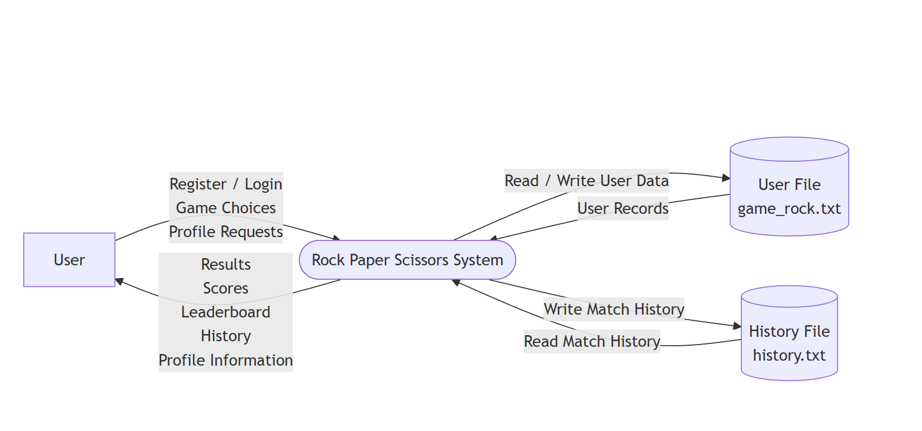
LEVEL 0 DFD
Shows the overall working of the Rock Paper Scissors Game.
Illustrates the interaction between the player and the system.
Represents the main input and output of the application.

Slide 7
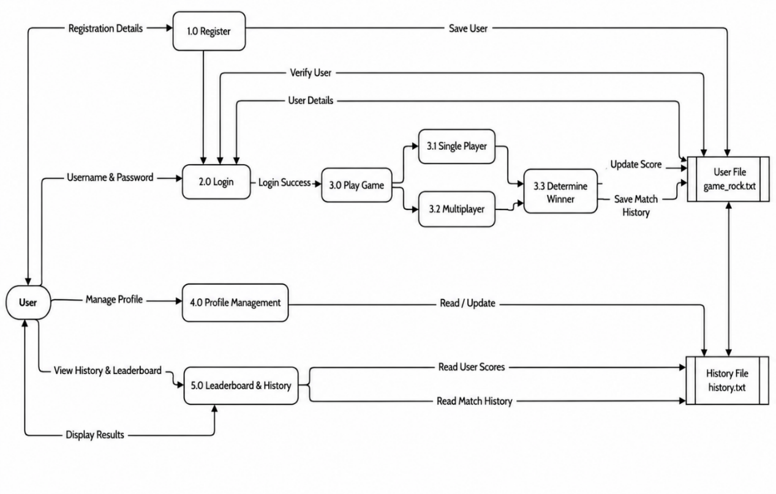
LEVEL 1 DFD
Shows the internal processes of the system.
Includes registration, login, gameplay, profile management, leaderboard, and match history.
Demonstrates the flow of data between users and the data files

Slide 8
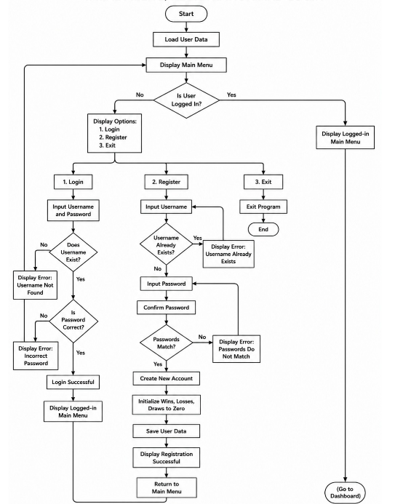
FLOWCHART FOR MAIN MENU, REGISTRATION AND LOGIN
Illustrates the sequence of user registration and login before accessing the game dashboard.

Slide 9
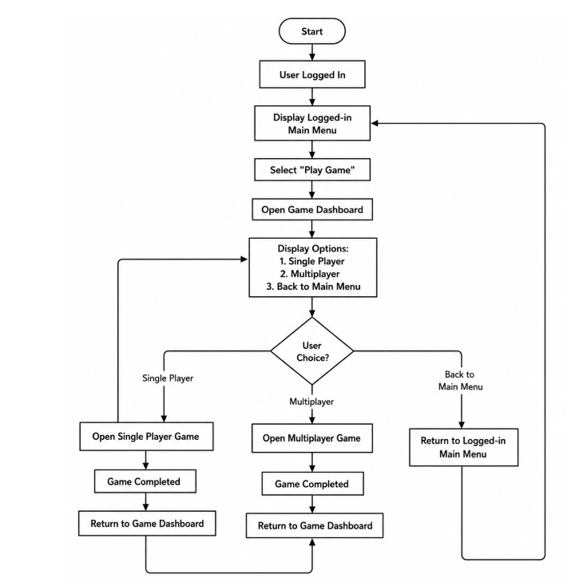
FLOWCHART FOR DASHBOARD
Shows the available options after successful login and the navigation to different modules of the system.

Slide 10
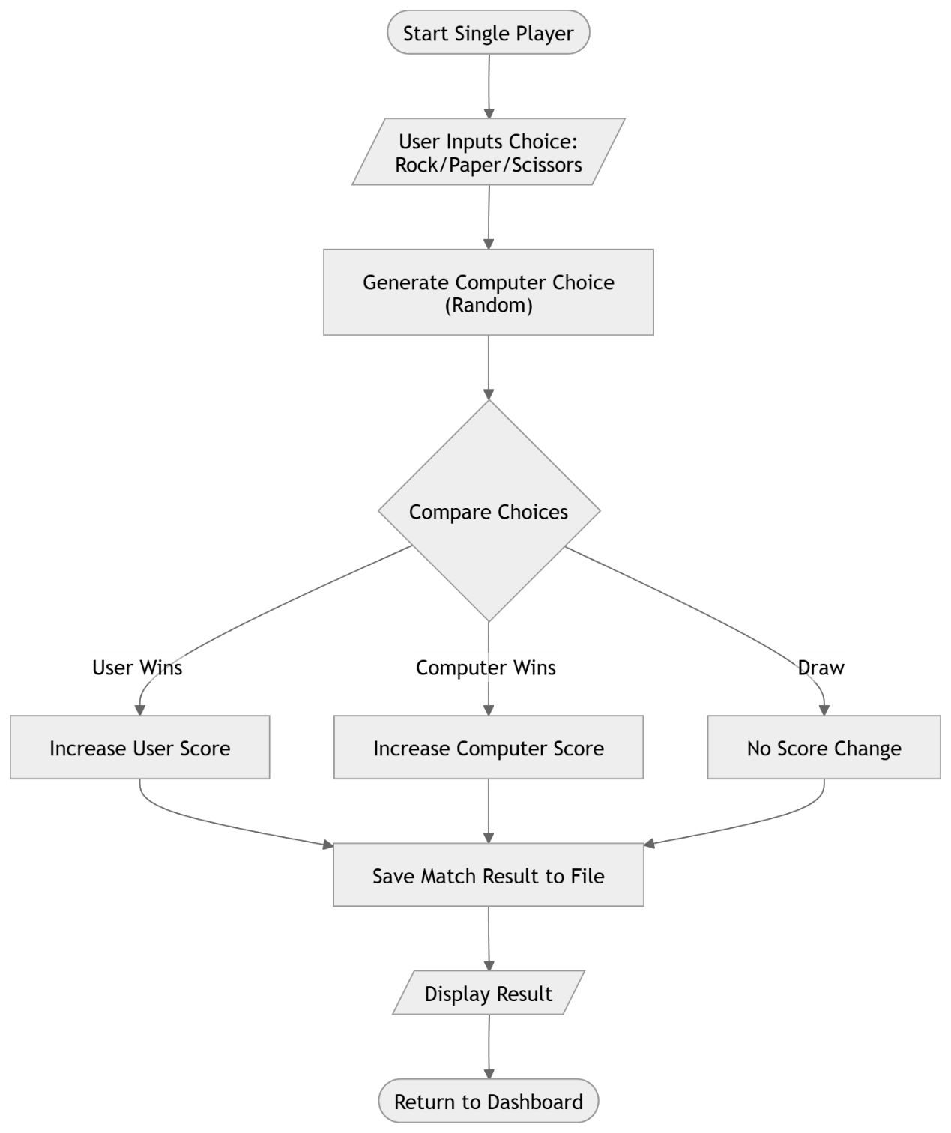
FLOWCHART FOR SINGLE PLAYER GAMEPLAY
Represents the process of playing against the computer and updating the game result.

Slide 11
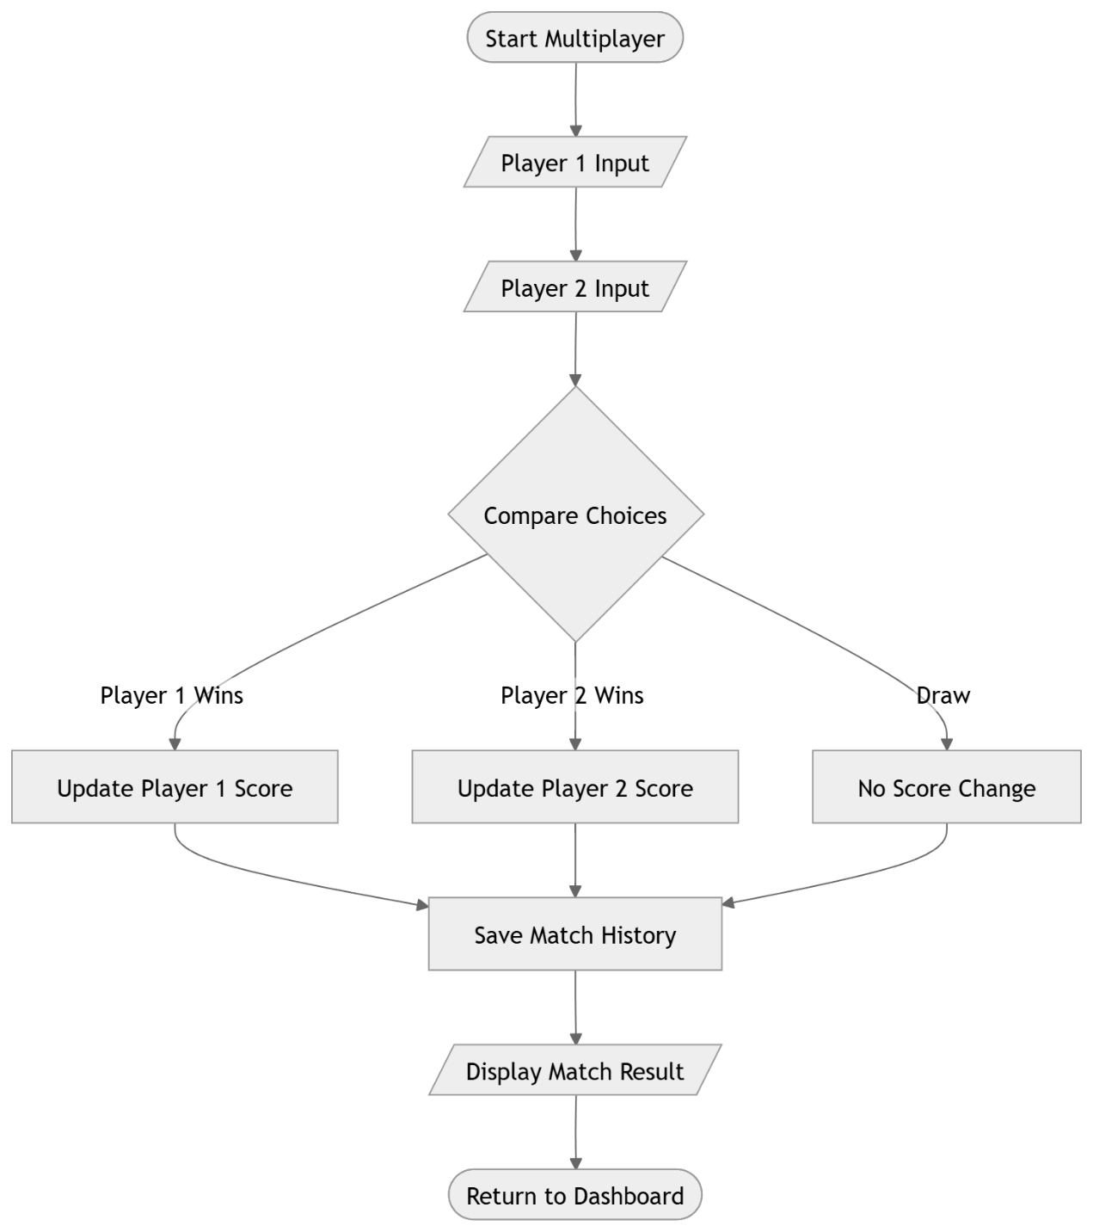
FLOWCHART FOR MULTIPLAYER GAMEPLAY
Shows the gameplay process between two registered players and the result generation

Slide 12
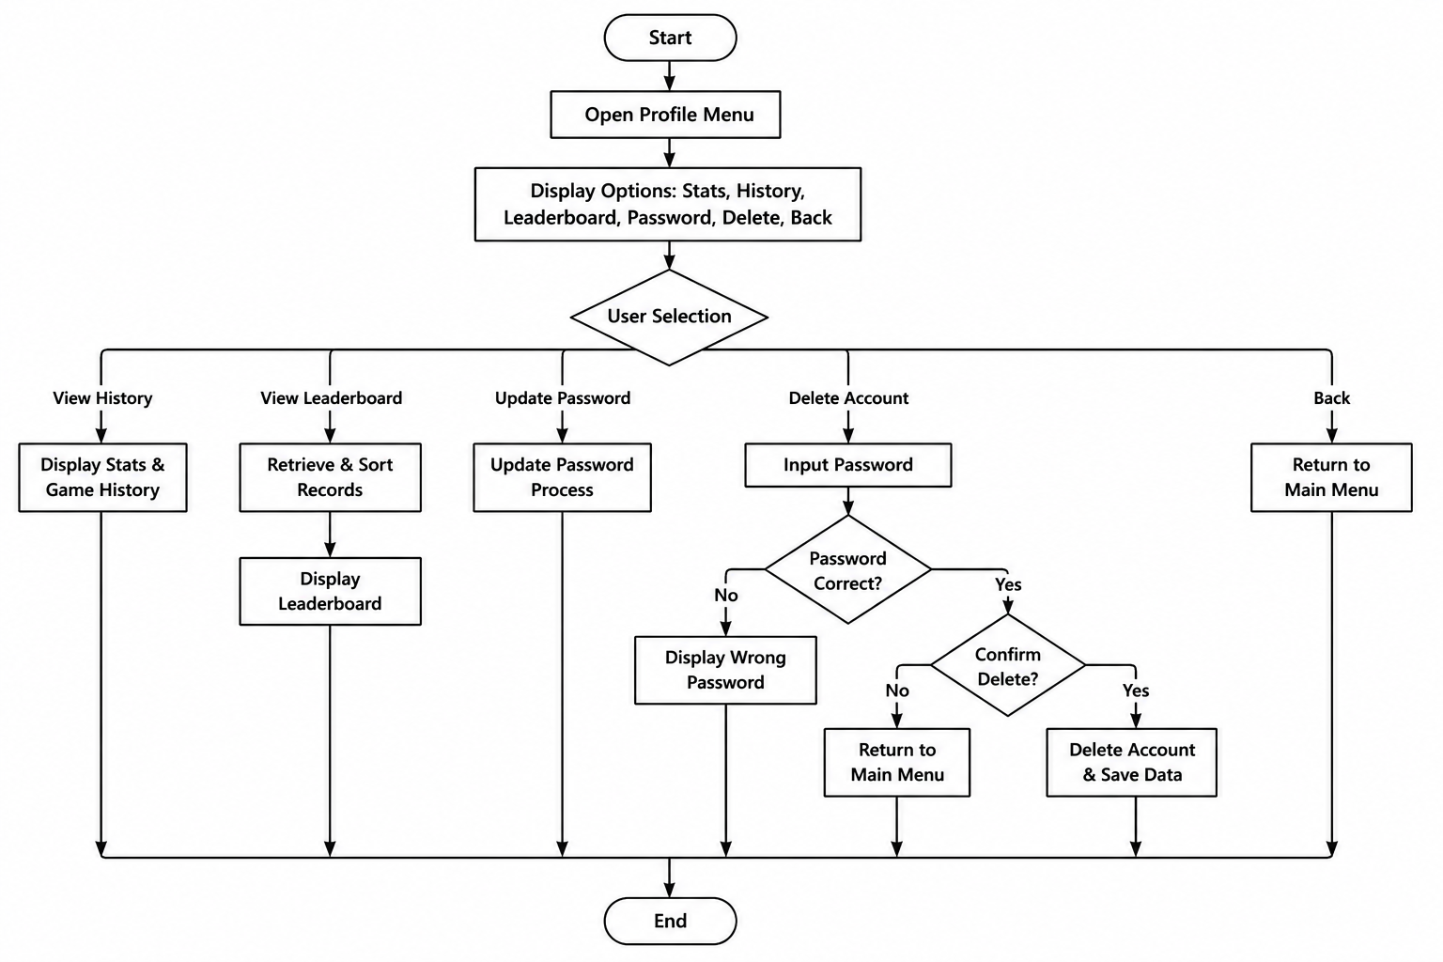
FLOWCHART FOR HISTORY, LEADERBOARD AND DELETE
Illustrates the process of viewing match history, leaderboard, and deleting a user account.

Slide 13
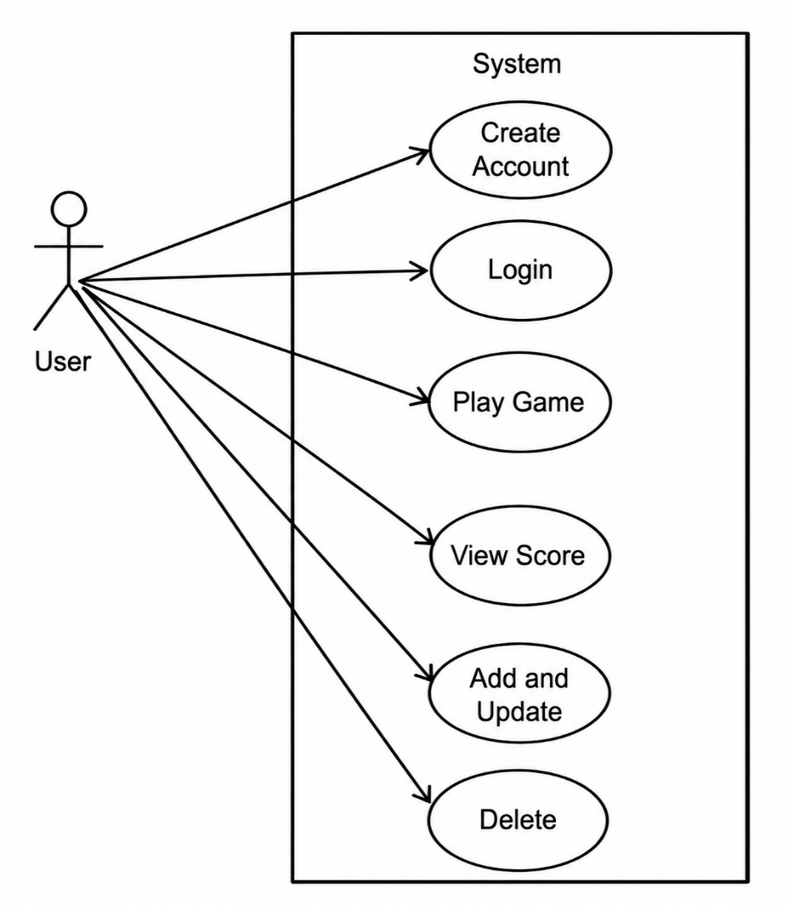
USE CASE DIAGRAM
The Use Case Diagram provides an overview of the system's functional requirements and shows how the user interacts with the different features of the application.

Slide 14
CONCLUSION
The Rock Paper Scissors Game was successfully developed using the C programming language.
The system provides user registration, login, single-player and multiplayer gameplay, leaderboard, and match history.
File handling enables permanent storage of player records and game statistics.
The project enhanced our knowledge of programming, file handling, teamwork, and software development.
Overall, the project achieved its objectives and can be further enhanced with GUI, database integration, and online multiplayer features.

